Slide 1
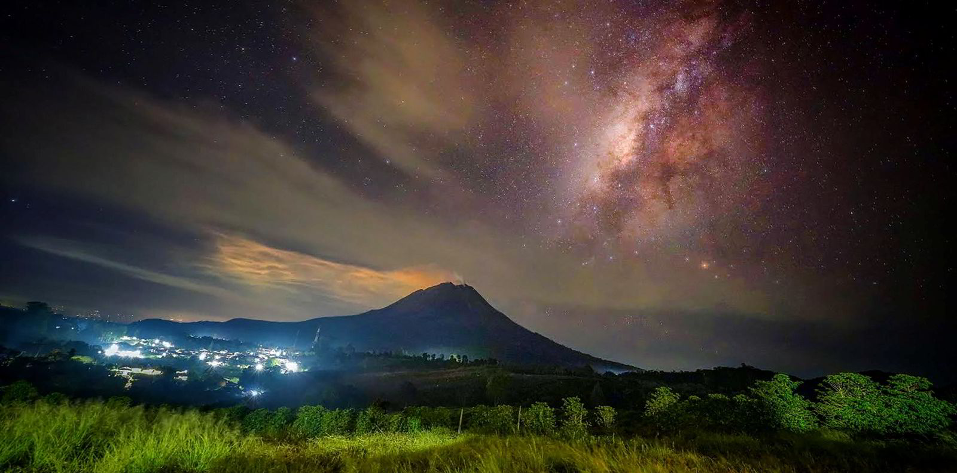
NYSE American: INDO
indo-energy.com
SEPTEMBER 2024
1

Slide 2
DISCLAIMERS AND CAUTIONARY NOTE ON FORWARD-LOOKING STATEMENTS
Readers are cautioned that the securities of Indonesia Energy Corporation Limited (“IEC”) are highly speculative. No representation or warranty, expressed or implied, is or will be made and, save in the case of intention or fraud, no responsibility or liability is or will be accepted by IEC or by any of its directors, employees, agents or affiliates as to or in relation to the presentation or the information contained therein or forming the basis of this presentation or for any reliance placed on the presentation by any person whatsoever. Save in the case of intention or fraud, no representation or warranty is given and neither IEC nor any of its directors, employees, agents or affiliates assume any liability as to the achievement or reasonableness of any future projections, targets, estimates or forecasts contained in the presentation.
This presentation contains or may contain forward-looking statements about IEC’s plans and future outcomes, including, without limitation, statements containing the words “anticipates”, “projected”, “potential” “believes”, “expects”, “plans”, ”estimates” and similar expressions. Such forward-looking statements involve significant known and unknown risks, uncertainties and other factors which might cause IEC’s actual results, financial condition, performance or achievements (including without limitation, the results of IEC’s oil exploration and commercialization efforts as described herein), or the market for energy in Indonesia, to be materially different from any actual future results, financial conditions, performance or achievements expressed or implied by such forward-looking statements. Given these uncertainties, you advised not to place any undue reliance on such forward-looking statements. These forward-looking statements speak only as at the date of this presentation. IEC expressly disclaims any obligation to update any such forward-looking statements in this presentation to reflect any change in its expectations with regard thereto or any change in events, conditions or circumstances on which any such statement is based, unless required by law or regulation. This presentation shall not constitute an offer to sell or the solicitation of an offer to buy our securities, nor shall there be any sale of securities in any jurisdiction in which such solicitation or sale would be unlawful prior to registration or qualification of our securities under the laws of any such jurisdiction.

Slide 3
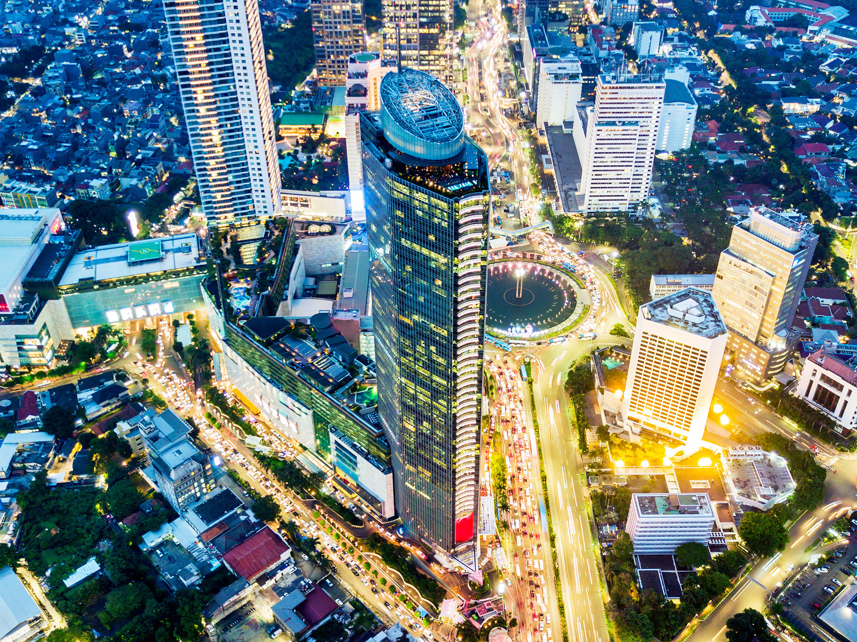
INDONESIA ENERGY
The Right Place at the Right Time
NYSE American: INDO (IPO in December 2019)
Drilled 4 successive oil discoveries & gas discovery in Kruh Block
Low Cost - High Value Production & Development Assets
Kruh Block: 5-year extension and improved contract terms:
Profit Oil: Increased 100%
Reserves: Increased 40%
Net Cash Flow: Increased nearly 300%
2024 Program in Kruh Block:
- Completed 29 sq km of a comprehensive 3D seismic program to maximize economic returns for our drilling program
- Commence new drilling operations in Q4 & drill 18 wells by 2026
Drive down production costs to below $20/barrel
Commenced operations on the 650,000 Acre De-Risked Citarum Block, a potential billion-barrel equivalent asset. Citarum Block has a 30-year term; natural gas prices are 200% higher than in USA and Block is only 16 miles form Jakarta

Slide 4
Indonesia Energy Assets
IEC Currently Owns a Producing Asset and a De-risked Development & Exploration Property
Stable cash flow generating asset owned controlled until 2030
160 BOPD average productivity in 2023
Currently producing from only 1 out of 7 structures
Average production costs in 2023 was $32 per barrel of oil
650,000 acre appraisal & development block controlled until 2048
16 miles from Jakarta → significant pipeline infrastructure in place
Adjacent fields producing 45,000 BOPD and 450 MMSCFD
“Derisked” asset with proven presence of hydrocarbons
~$40M invested by prior owner, Pan Orient Energy, drilled 4 discovery wells
Downstream integration opportunities
Stable cash flow generating asset owned controlled until 2030
160 BOPD average productivity in 2023
Currently producing from only 1 out of 7 structures
Average production costs in 2023 was $25 per barrel of oil
KRUH BLOCK
(PRODUCTION)
CITARUM BLOCK
(APPRAISAL & DEVELOPMENT)
KRUH
CITARUM

Slide 5
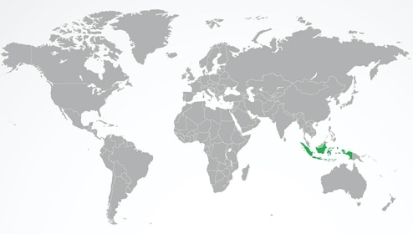
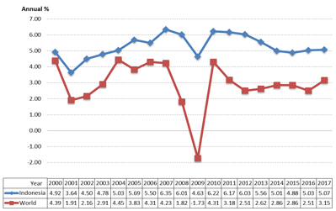
Indonesia’s Growth Opportunities
Largest economy in S.E. Asia, fourth most populous nation (>274MM), 10th largest global economy and a member of the G-20
Annual GDP Growth: Indonesia vs. World
Area
735,358 sq.miles
"Designed by Freepik"
Capital
Jakarta
Source: data.worldbank.org/indicator
World's largest island country
Over 17,000 islands
Coastline of 50,331 miles
7th largest in combined sea & land area
14th largest by land area
Population
Over 274MM (2021)
World ranking: 4th
Work force over 50% of population,
major concentration on Java island
Languages
Official: Bahasa Indonesia
English is widely used, the standard for O&G industry
Agriculture
Produces rice, palm
oil, tea, coffee, cacao,
medicinal plants, spices
and rubber
GDP 2022
$1.3 trillion (10th largest economy)
$4,691 per capita
5.4% (2022 average)
Rich in natural resources
Oil, natural gas, tin, copper and gold
A leading global thermal coal exporter
2nd largest tin producer
Currency Indonesia Rupiah
Rp14,581 per US$
(June 2022 average)
Legal Framework
Civil Law
Mature legal framework for O&G
Sources: www.worldbank.org/en/country/indonesia/overview, Marine And Fisheries Ministry Republic Of Indonesia The World Fact Book-www.cia.gov, The World Bank-www.data.worldbank.org, Bank of Indonesia, The World Justice Report 2021

Slide 6
Indonesia’s Growing Demand for Energy
Demand for energy is only expected to grow in the years to come,
especially in the region where IEC’s gas asset is located (West Java)
Years 2021 to 2050
Electricity Demand Increase by 2050
630%
Natural Gas Demand Growth
6.3% / Year
Total Energy Demand Growth
5.0% / Year
Industrial Sector Energy Demand Growth
6.1% / Year
Natural Gas Demand for Electricity Growth
4.9% / Year
Transportation Sector Energy Demand Growth
4.6% / Year
Gas Market Potential in West Java
Country/Regional Outlook
Indonesia's gas market is expected to expand to support the growing economy
West Java expects gas demand to increase from 2,521 MMSCFD in 2020 to 3,032 MMSCFD in 2035
Annual growth of gas transmission and distribution pipeline was 6.5% in 2021
Indonesia’s Government Interest
Initiated incentive plans to attract investors for development of new O&G blocks
Introducing a new Production Sharing Contract (“PSC”) plan based on the sharing of a “Gross Production Split”
PSC provides O&G companies flexibility in operational activities to promote cost efficiency and reducing delays
Ongoing government involvement in approving key regulations of upstream business developments (i.e. from the PSC award up to production)
Estimated Gas Shortage in 2028
1,836 MMSCFD
Source: Indonesian Agency for the Assessment and Application of Technology (BPPT) - Indonesia Energy Outlook 2020; PWC - Oil and Gas in Indonesia: Investment and Taxation Guide 2021- BP 2021 Report

Slide 7
Oil Majors Continue to Invest Billions in Indonesia
Indonesia Fact: Exploration Drilling Success Ratio 2012 - 2020
Year | 2012 | 2013 | 2014 | 2015 | 2016 | 2017 | 2018 | 2019 | 2020
Exploration Wells | 96 | 75 | 64 | 33 | 33 | 15 | 22 | 26 | 28
Discovery Wells | 65 | 53 | 47 | 27 | 23 | 10 | 13 | 8 | 12
Success Ratio | 68% | 71% | 73% | 82% | 70% | 67% | 59% | 31% | 43%
Average drilling success ratio from 2012 to 2020 |  |  |  |  |  |  |  |  | 66%
Source: SKK Migas, Annual Report

Slide 8
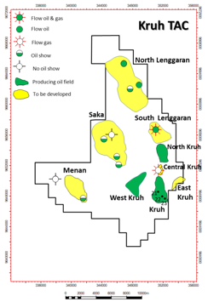
KRUH: Producing Cash Flow Asset
Stable cash generating oil asset, with 18 new wells planned to increase production significantly
Optimize block’s upside potential to increase reserve value
Increase production delivering on plan of 18 new wells by 2026
Generate free cash flow and increase IEC’s value
Lower production costs to below $20/barrel
Contract Type | Joint Operation Partnership (KSO)
Fiscal Terms | Cost Recovery
Contract Renewal Effective Date | May 22, 2020
Contract Expiry Date | September 2035
Participating Interest | 100%
Concession Area | 258 km² / 63,753 acres
Average 2022 Production
~160 BOPD
Average Production Cost
~ $25 / Bbl.
Crude Oil Proved Reserves - December 31st 2024 (in Bbl.)
Crude Oil Reserves | Gross | Net
Crude Oil Developed Producing Reserves | 371,076 | 213,582
Crude Oil Proved Undeveloped Reserves | 1,685,331 | 970,033
Total | 2,056,407 | 1,183,614
KRUH: Short–to-Medium Term Objectives
Average 2023 Production
~160 BOPD
# of Active Wells
6
Average Production Cost
~ $32 / Bbl.
Optimize block’s upside potential to increase reserve value
Increase production delivering on plan of 18 new wells by 2027
Generate free cash flow and increase IEC’s value
Lower production costs to below $20/barrel
Crude Oil Proved Reserves - December 31st 2024 (in Bbl.)
Crude Oil Reserves | Gross | Net
Crude Oil Developed Producing Reserves | 335,191 | 247,291
Crude Oil Proved Undeveloped Reserves | 3,080,960 | 2,273,006
Total | 3,416,151 | 2,520,297
KRUH Reserves Development Plan (2024 onward till 2035)
Assumptions |  | Development Plan
Indonesian Crude Price | $ 77.61/ Bbl. | New Wells in 2021/22 | 4 PUD Wells
Recovered Reserve | 3.42 MMSTB | New Wells in 2024/25 | 5 PUD Wells
Project Time | 12 Years | New Wells in 2026/27 | 9 PUD Wells
Discount Rate | 10% | ~ Cost per Well | $ 1.5 million
Initial Investment | $15.5 million | Future Net Revenue | $ 265 million
KRUH Reserves Development Plan (2024 onward till 2035)
Assumptions |  | Development Plan
Indonesian Crude Price | $ 81.91/ Bbl. | New Wells in 2021/22 | 4 PUD Wells
Recovered Reserve | 2.01 MMSTB | New Wells in 2024/25 | 10 PUD Wells
Project Time | 10 Years | New Wells in 2026 | 4 PUD Wells
Discount Rate | 10% | ~ Cost per Well | $ 1.5 million
Initial Investment | $15.5 million | Future Net Revenue | $ 167 million
^{* Excluding upside potential}
* Financial projection based on reserves development of Kruh Block under KSO contract, excluding upside potential.

Slide 9
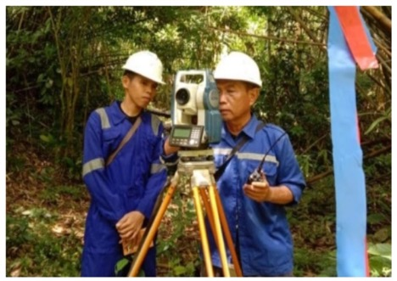
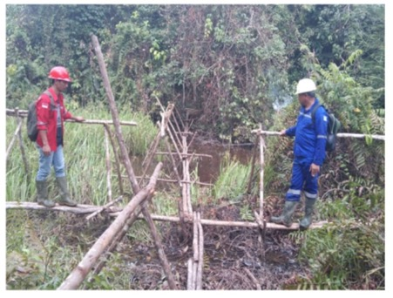
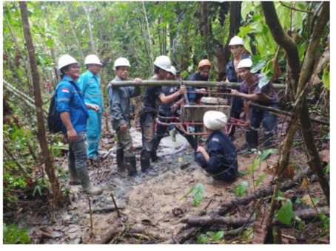
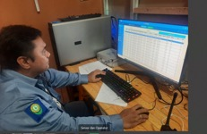
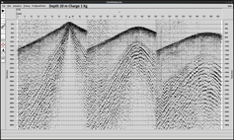
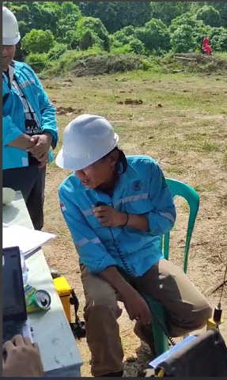
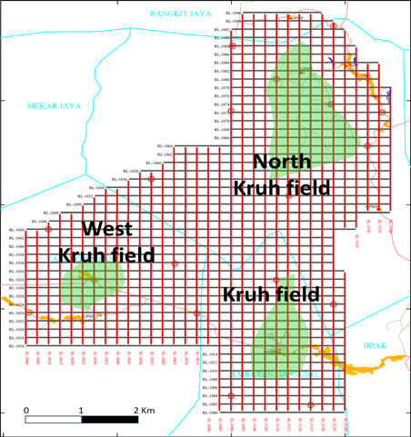
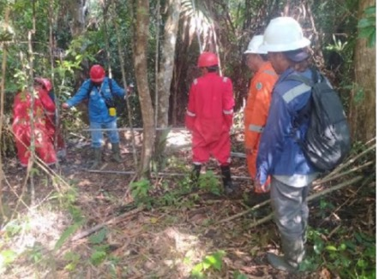
KRUH: 29 km² Seismic Program Completed in July 2024 Data processing currently in progress
Topo survey Bridging Shot hole drilling
Preloading explosives Recording 29 Km 3D Seismic

Slide 10
KRUH: Drilling Program 2021 - 2024
Drilled 4 consecutive Oil Discoveries: 100% Success Rate !
New Gas Zone Discovered !

Slide 11
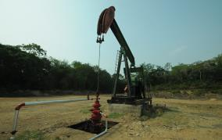
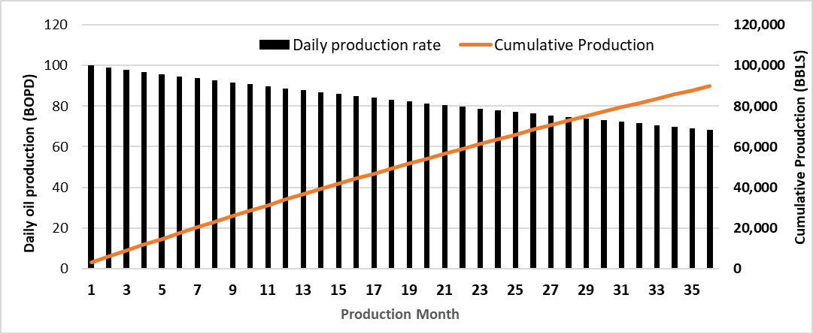
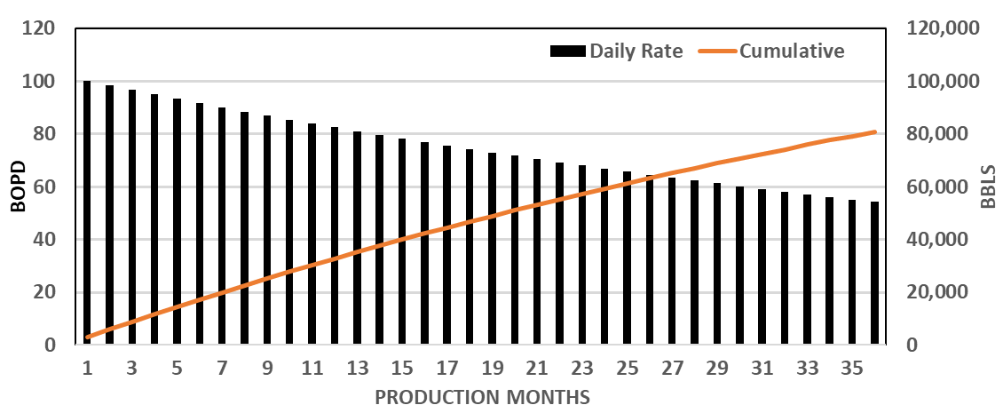
HISTORICAL WELL DATA |  | OPERATING INDICATORS & ASSUMPTIONS
Location | Kruh Block, South Sumatra | Well Depth – TVD Average | 3,300 feet
Number of wells drilled | 29 wells | Oil Realization Discount | 0%
Average 1st Year Daily Production | 127 BOPD | Production Operation Cost per Bbl (2023) | $25.00 / Bbl
Average 1st Year Gross Production | 46,341 Bbl | Well Drilling and Completion Cost | $1,500,000
Production Type | 100% Crude Oil | Decline Rate | 21%
Well Type | Infill Vertical Well | Lifting Method | Artificial Lift
KRUH: Single Well Economics
HISTORICAL WELL DATA |  | OPERATING INDICATORS & ASSUMPTIONS
Location | Kruh Block, South Sumatra | Well Depth – TVD Average | 3,300 feet
Number of wells drilled | 29 wells | Oil Realization Discount | 0%
Average 1st Year Daily Production | 127 BOPD | Production Operation Cost per Bbl (2023) | $32 / Bbl
Average 1st Year Gross Production | 46,341 Bbl | Well Drilling and Completion Cost | $1,500,000
Production Type | 100% Crude Oil | Decline Rate | 13%
Well Type | Infill Vertical Well | Lifting Method | Artificial Lift
AVERAGE KRUH WELLS ECONOMIC INDICATOR
Monthly Production | Kruh Block, South Sumatra
Initial Production | 100 BOPD
Oil Price (US$/Bbl) | $80/Bbl | $90/Bbl
1st Year Net Revenue | ~ $ 2.1 million | ~ $ 2.3 million
First 6-months Net Revenue | ~ $ 1.1 million | ~ $ 1.2 million
1st Year Net Cash Flow | ~ $ 1.2 million | ~ $ 1.4 million
AVERAGE KRUH WELLS ECONOMIC INDICATOR
Monthly Production | Kruh Block, South Sumatra
Initial Production | 100 BOPD
Oil Price (US$/Bbl) | $80/Bbl | $90/Bbl
1st Year Net Revenue | ~ $ 2.2 million | ~ $ 2.4 million
First 6-months Net Revenue | ~ $ 1.1 million | ~ $ 1.3 million
1st Year Net Cash Flow | ~ $ 1.1 million | ~ $ 1.3 million
AVERAGE HISTORICAL WELL PRODUCTION PROFILE

Slide 12
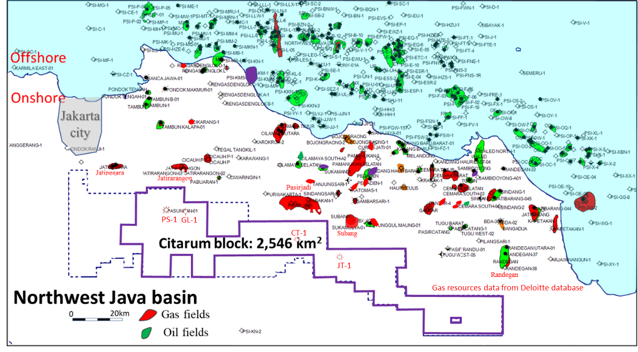
CITARUM: “Derisked” ~ 650,000 Acre Property
INDONESIA INDUSTRY
Proven hydrocarbon presence located 16 miles from Jakarta, a metropolitan area with large & growing gas demand and established gas pipeline infrastructure network
Producing O&G Fields in Northwest Java Basin
Block | CITARUM
Contract Type | Production Sharing Contract
Fiscal Terms | Gross Split
Contract Expiration Date | July 5, 2048
Acreage | 650,000 acres
Opportunity
Combined Oil Production in Northwest Java Basin
Combined Gas Production in Northwest Java Basin
Citarum block shares its border with producing gas fields of Subang, Pasiriadi, Jatirarangon and Jatinegara
Existing pipeline network allows the gas produced from Citarum to be directly distributed into the market
For past nine years, success ratio of Indonesian exploration drilling was about 66%
Citarum’s economic model assumes a conservative 28% exploration success rate, producing in 8 out of 28 prospects in the block
45,000 BOPD
450 MMSCFD

Slide 13
CITARUM: A Proven Hydrocarbon Opportunity
From 2009-2016, over $40M was invested in Citarum by previous operator Pan Orient Energy Corp (TSXV:POE)
POE drilled 4 wells and discovered natural gas and gas flow from each well
Pasundan-1:
Gas depth between
6,000-9,000ft.
Cataka-1:
Gas depth between
1,000-2,737ft.
Jatayu-1:
Gas depth between
5,800-6,700ft.
Geulis-1:
Gas depth between
1,000-4,300ft.
With gas depths between 1,000 to 6,000ft., the potential for commercially developable gas discoveries is high
Large capex program by previous operator that successfully discovered hydrocarbons derisked our unique development asset
As an experienced operator, IEC has an opportunity to acquire significant market share via the Citarum appraisal and development program

Slide 14
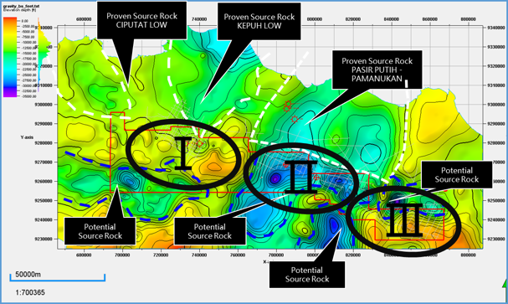
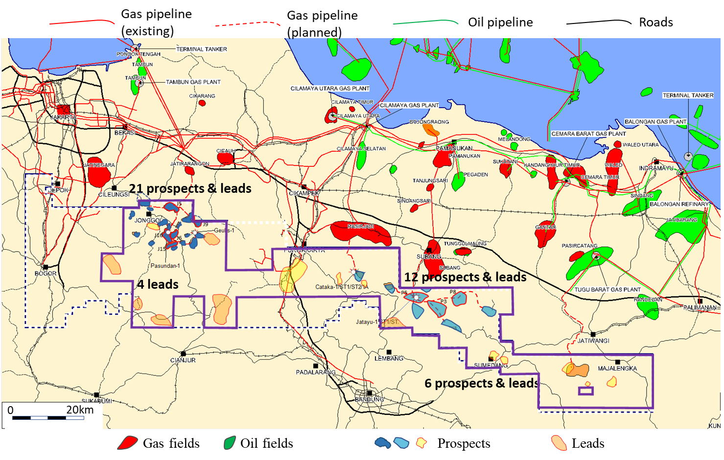
CITARUM: Appraisal & Development Program
3 Year Exploration & Appraisal Program
Year | 1 | 2 | 3
Activity | Geological and Geophysical Studies | Drilling: First exploration well (Jonggol Area) | Drilling: 2 delineation wells
 | 2D Seismic (300 km²) | 3D Seismic (100 km²)* | Propose Plan of Development Phase 1
First Priority: Confirm the Value of the Block by Proving Reserves and Monetize the Asset through Production and Sale of Gas
Citarum 3 areas division map: I. Jonggol; II. Purwakarta-subang; and iii. majalengka
At least 7 proven sources rock, “kitchens”, are located north (and possibly more in the south) of the block.
*3D Seismic, drilling of delineation wells and first plan of development are subject to having discovery.
West Java Oil & Gas Transmission Network Map
Economic model: assuming success on only 8 out of 28 prospects (or more)
Development from West to East
JONGGOL:
19 prospects
PURWAKARTA:
9 prospects
MAJALENGKA
Under evaluation

Slide 15
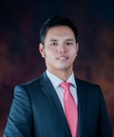
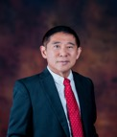
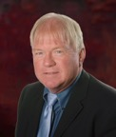
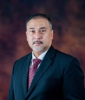
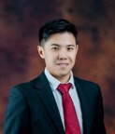
Executive Team
IEC’s executive team is built to capture opportunities in Indonesia and execute projects with excellence
Chairman & Chief Executive Officer
Dr. Wirawan Jusuf
President
Frank Ingriselli
Co-founder and founding Chairman of the board of directors
Strong qualifications in business development, government relations and strategic planning
Master’s in Public Health at the Gajah Mada University-Jogjakarta in Central Java, Indonesia, and medical degree at the University of Tarumanegara in Jakarta, Indonesia
Holds professional memberships with the Indonesian Petroleum Association (IPA) and Officer in Indonesian Doctors Association (IDI)
Seasoned leader and entrepreneur with over 40 years of wide-ranging oil exploration and production experience in diverse geographies, business climates and political environments
Former President of Texaco International’s operations, a capacity that directed Texaco’s global initiatives in E&P
Previous founder and CEO of two public NYSE listed energy companies
BSBA from Boston University, an MBA from New York University and a JD from Fordham School of Law
Chief Technology Officer
Dr. Chiahsin “Charlie” Wu
Chief Financial Officer
Gregory Overholtzer
Highly qualified and recognized oil and gas industry veteran with over 40 years of global energy experience
Responsible for building and leading the upstream exploration and production teams for 3 independent O&G companies in Indonesia over the last 15 years
Postgraduate Diploma in Business Administration at DeMontfort University, and Ph.D. in Geosciences at the University of Texas
Experienced Chief Financial Officer for oil and gas public corporations
Served as PEDEVCO’s (PED:NYSE) CFO prior to joining IEC in early 2019
Former CFO, Corporate Controller or Senior Director for seven different companies engaged in various industries: hi-tech, bio-tech and energy industries
MBA and BA degree from the University of California, Berkeley
Chief Operating Officer
Mirza F. Said
Chief Investment Officer
James J. Huang, CFA
Experienced oil and gas veteran with expertise within the energy and infrastructure sector
Master of Engineering Management, Curtin University of Technology in Perth, Australia, and Bachelor’s degree in Engineering at the Chemical Engineering Institute Technology of Indonesia
Holds professional memberships with the Indonesian Petroleum Association (IPA) and Society of Indonesian Petroleum Engineers (IATMI)
Co-founder of IEC with educational and career background in finance, law and business management
Holds the Chartered Financial Analyst (CFA) designation
Maintains an Attorney at Law professional license from the Brazilian Bar Association (OAB/SP)
Bachelor’s degree in law at the São Paulo Law School of Fundação Getúlio Vargas and participant in the Double Degree Business Management Program at the São Paulo Business School of Fundação Getúlio Vargas

Slide 16
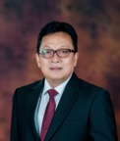
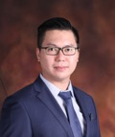
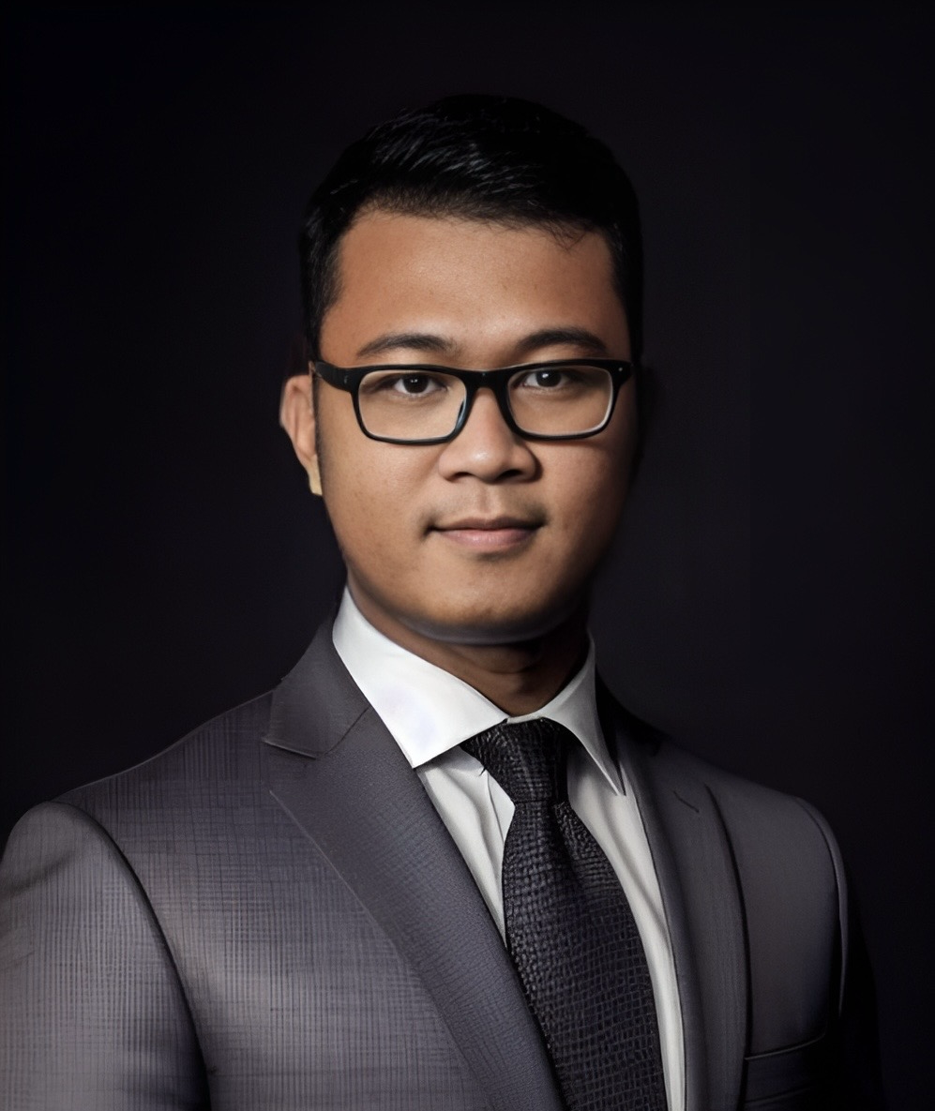
Board of Directors
IEC’s board of directors is built to capture opportunities in Indonesia and execute projects with excellence
Director
Mochtar Hussein
Director
Michael L. Peterson
Rich experience in fields of investigative auditing, compliance and corporate governance
Served as Inspector General of The Ministry of Energy and Mineral Resources of the Republic of Indonesia in 2013-2018
Served as Commissioner of PT Timah (Persero) Tbk, an Indonesian state owned enterprise engaged in tin mining and listed on Indonesia Stock Exchange from 2014 to 2018
Holds a Forensic Auditor Certification
Bachelor’s degree in Economics at the Brawijaya University, Malang in East Java
A highly qualified financial executive with broad experience in building and leading companies. He began his career with 10 years at Goldman Sacs, and 5 years at Merrill Lynch, then left his investment banking career to personally invest in and help build companies and manage their growth
Has served as CEO of two public companies, including NYSE listed oil and gas company
Has been a member of the board of directors for 6 U.S. publicly listed companies, and served as Chairman of the Audit Committee on 2 of these boards
Previously served as CFO of a publicly listed company where he successfully executed a restructure of $85 million of debt to equity and raised over $50 million in equity and $100 million in debt
Director
Benny Dharmawan
Director
Ahmad Fathurachman
Served as Director of PT Panasia Indo Resources Tbk., a holding company that primarily engages in yarn manufacturing, synthetic fibres and mining
Acted in several executive positions with the Macquarie Group from 2007 to 2015
Earned Graduate Certification in Applied Finance and Investments in Kaplan, Australia, and Bachelor’s degree in Commerce at the Macquarie University in Australia
Holds the Certified Anti Money Laundering Specialist (CAMS-ACAMS) credential
Experienced oil and gas professional with expertise within the energy and digital oilfield solutions
Responsible for building and leading the oilfield digitalization and production optimization systems for Oil & Gas companies in Indonesia.
Bachelor’s degree in Electrical Engineering at the Jenderal Achmad Yani University, Indonesia
Note: Executive Officers: Dr. Wirawan Jusuf, James J Huang and Mirza F Said also serve as Directors of Indonesia Energy Corp.

Slide 17
A Commitment to Driving Results
Operating Plans to Create Long-Term Shareholder Value
Completed 29 sq. km. comprehensive #D seismic program to maximize economic returns on investment and drive down production costs to below $20/barrel
Commence continuous drilling program on Kruh Block in Q4 2024
Drilled 4 consecutive oil discoveries and evaluating a new potential gas zone and 2 new oil formations
Plan to commence operations on 650,000 Acre De-Risked Citarum Block to Unlock Potential $1 billion Resource Value
Maintain Strong Balance Sheet to Offset Commodity Cyclicality
Fund E&P Activities with Free Cash Flow, Moderate use of Debt and Equity
Focus on Validating the Reserves of our Blocks to Provide Growth Trajectory

Slide 18
THANK YOU

